Slide 1
Development Sites within Cambridge, UK
By Chris Winnard

Slide 2
The Project
Breakdown the City into Clustered Candidate Areas
Provide Visual information on Sites locations
Provide Numerical Information on Proximity to Train Stations
Determine which areas are ‘Safest’ according to data on local crimes reported from Cambridge Police
Provide information on Local venues within Cambridge
Clusters and sub-group the venues according to area to help identify areas that appeal to demongraphic

Slide 3
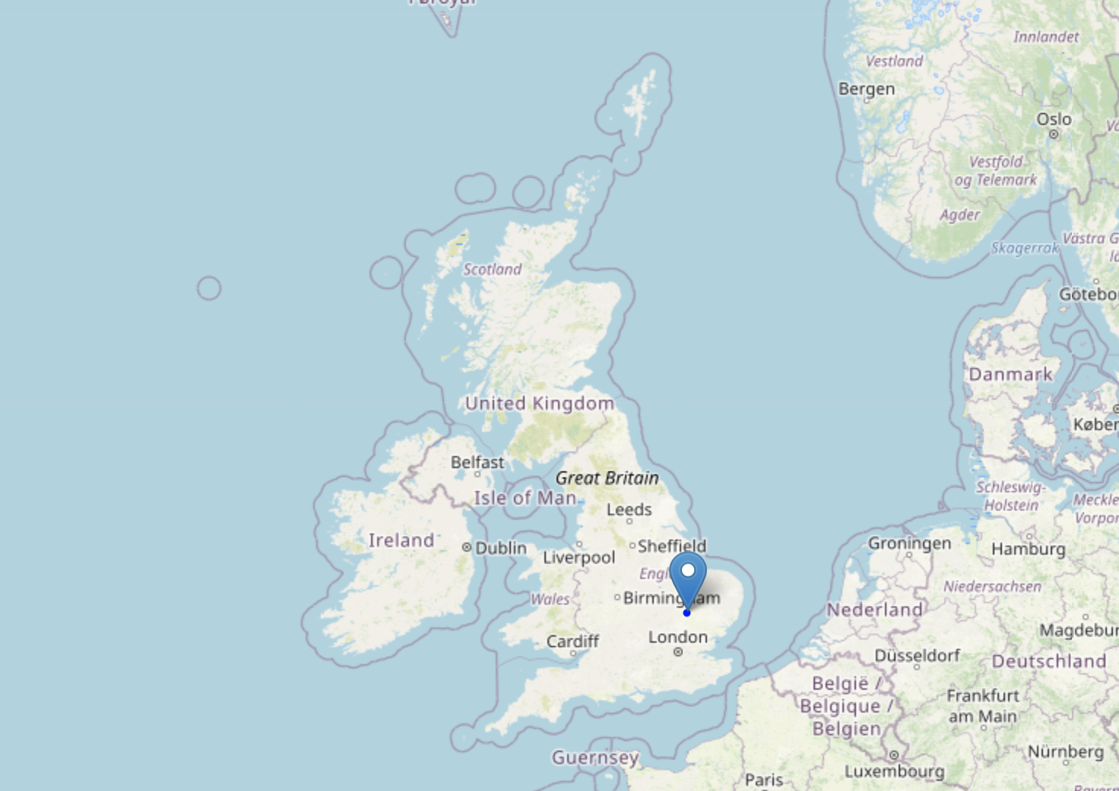
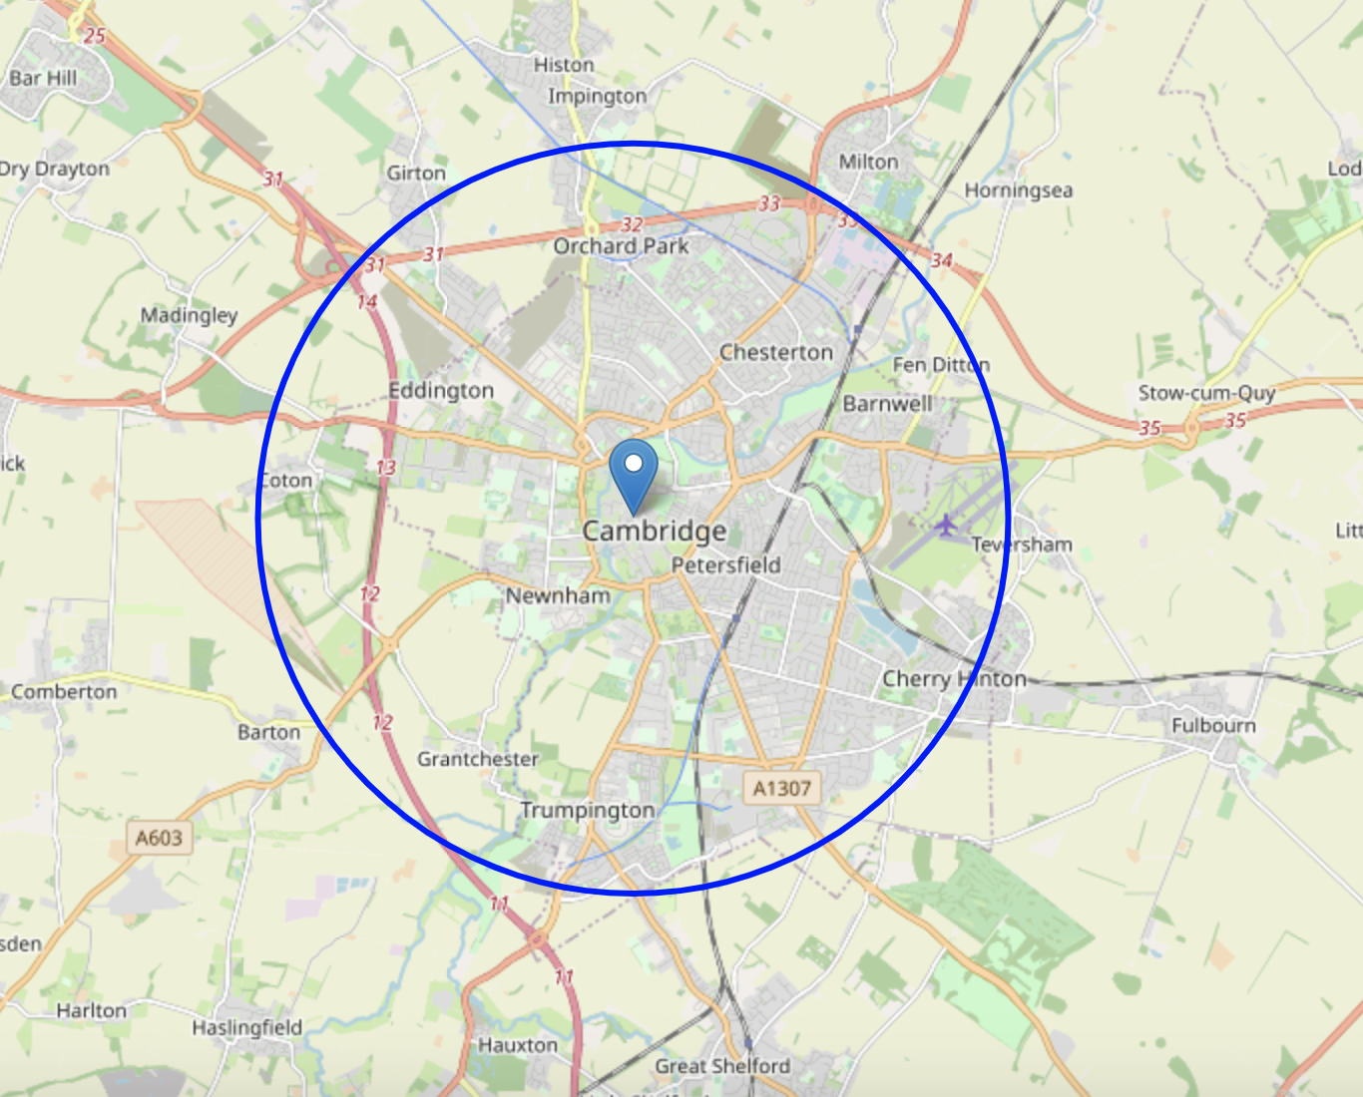
The City – Location of Cambridge, UK

Slide 4
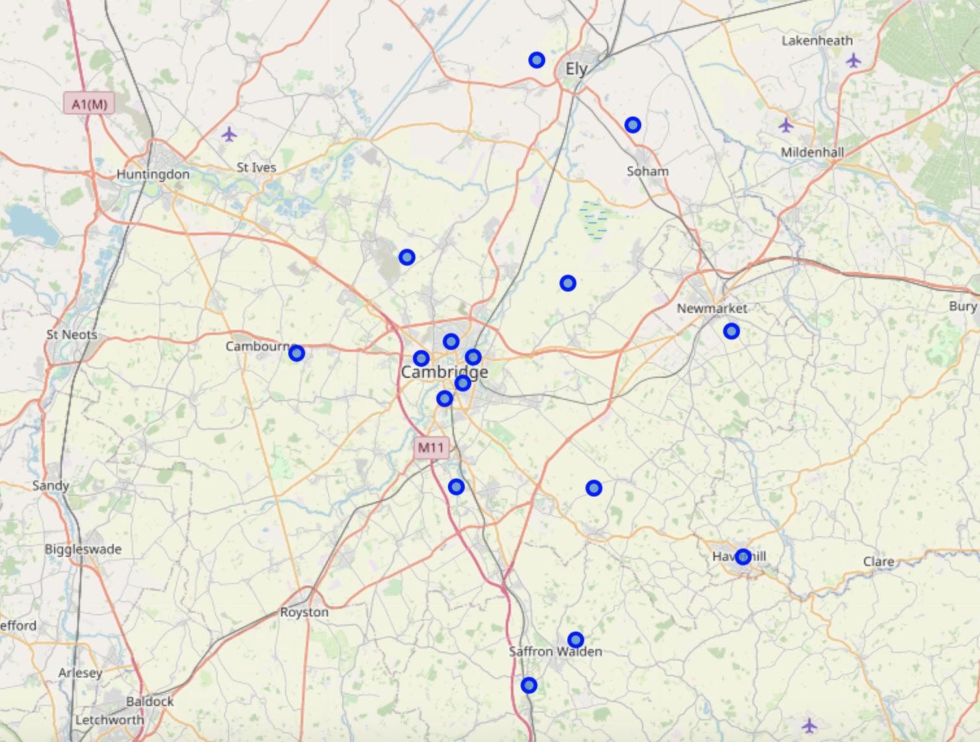
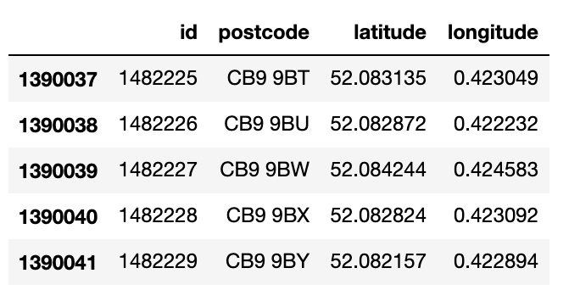
Post Codes
Created and maintained by Governments
Royal Mail Postal Service, grid system for
Country splits it into over 190,0000 different
Locations.
We have clustered these into larger location
Fields.

Slide 5
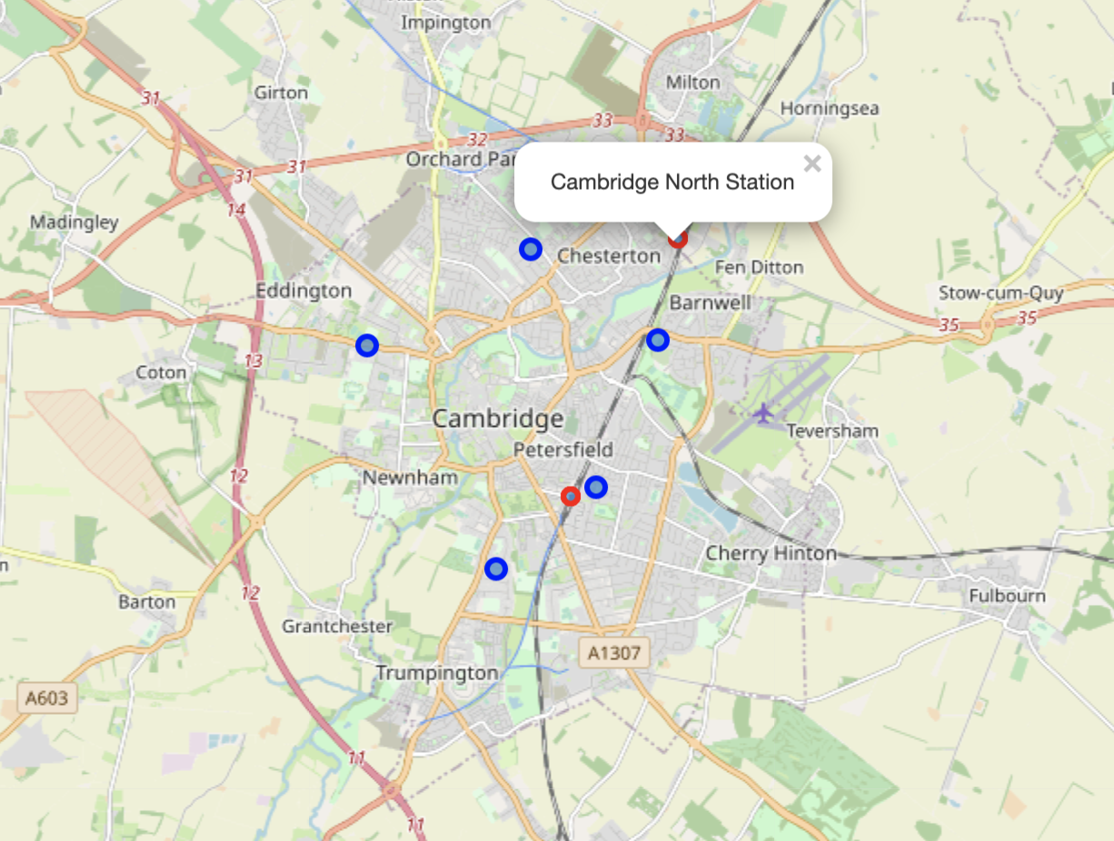
Candidate Areas
5 candidate Areas clustered and created that are distributed across the city
Red circles denote 2 train stations within city

Slide 6
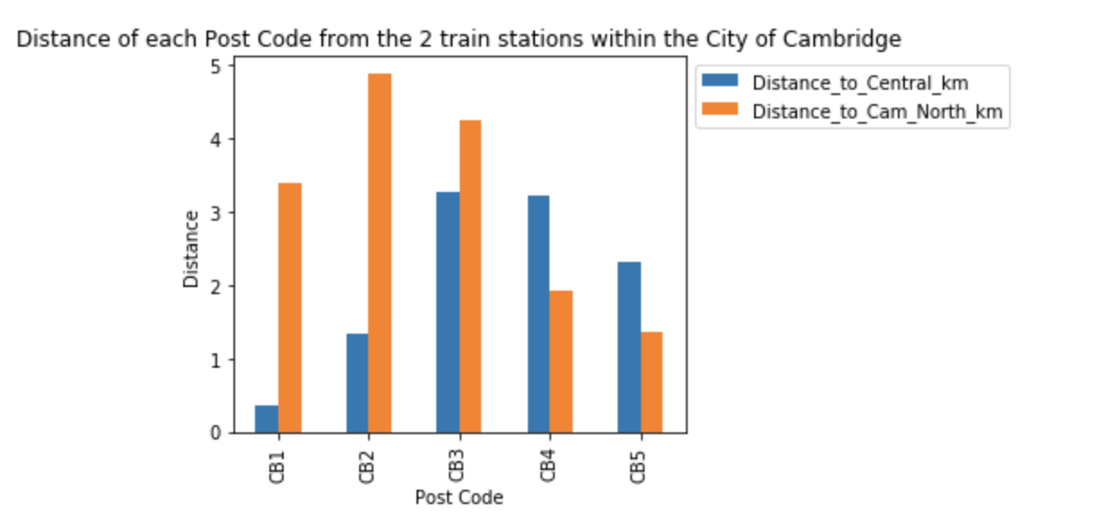
Cambridge Train Stations
Proximity to train stations are
Important to potential clients who
may commute to work
CB1 closest to Central but far
from Cambridge North Station
CB4 and CB5 roughly even
distance to both stations

Slide 7
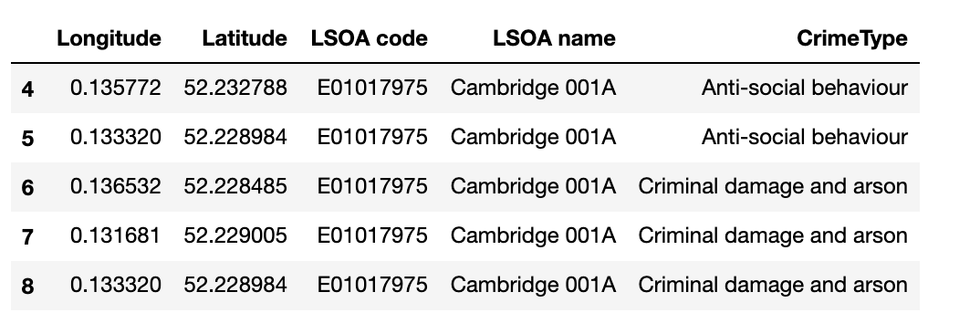
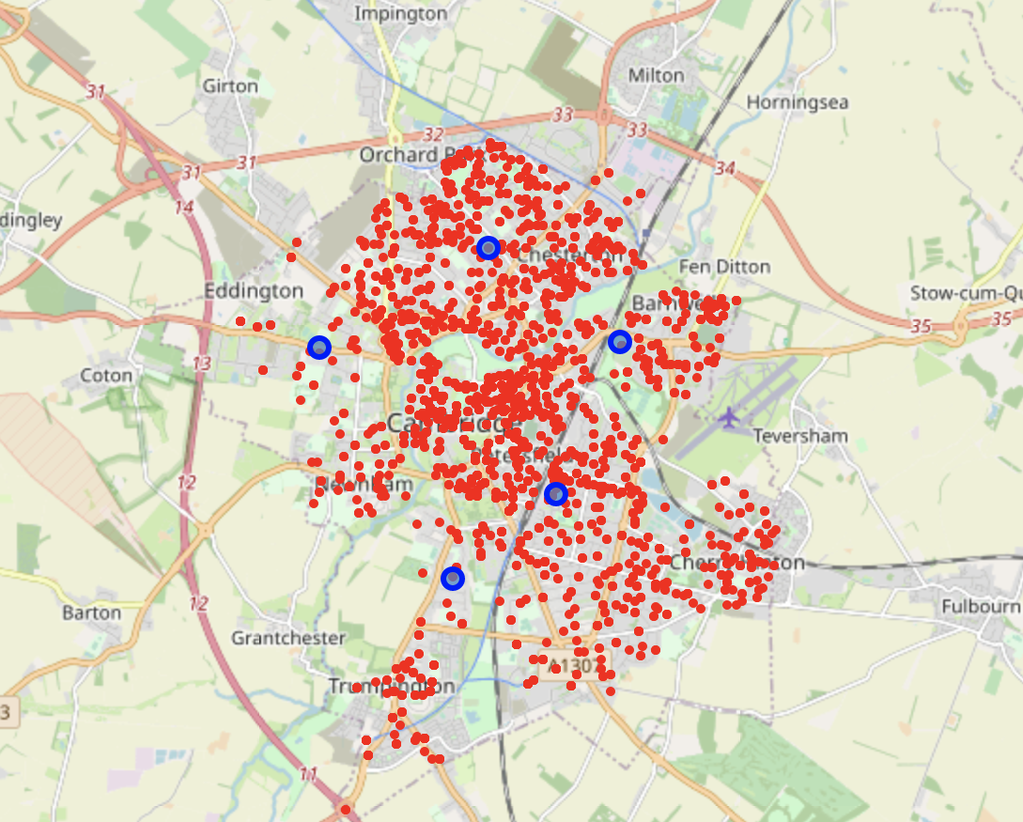
Crime stats
Crime stats collected from local police forces over last 6 months
Crime types categorized and visualized on interactive map
Crime clusters around central location

Slide 8
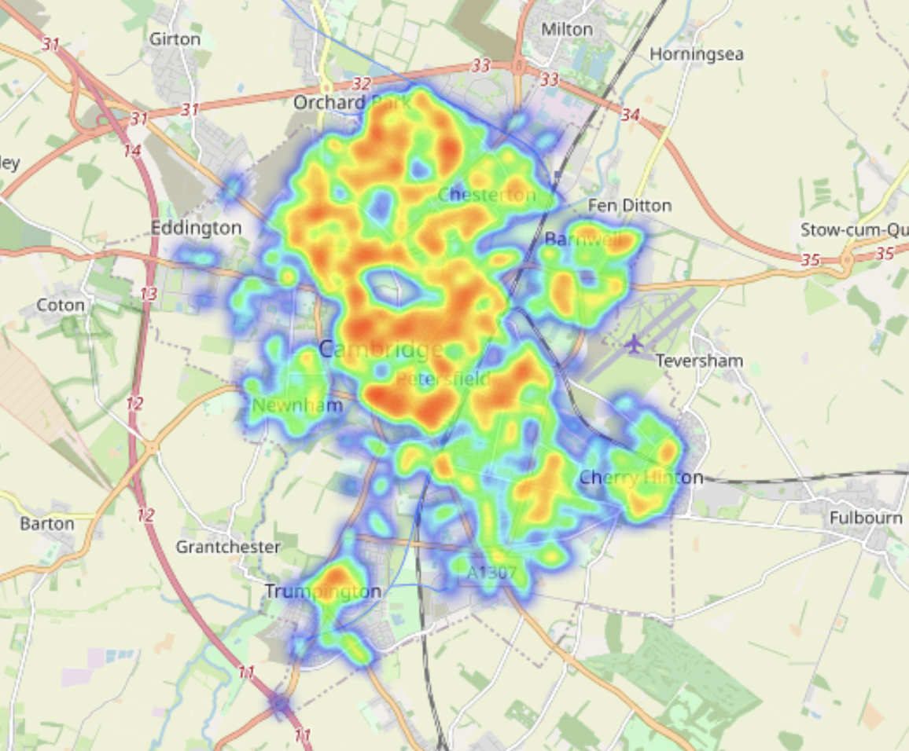
Crime Stats Continued
Heat map created based on crimes displays that
Lower districts within City (CB2) display less
intensity of crimes

Slide 9
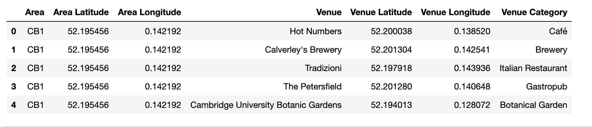
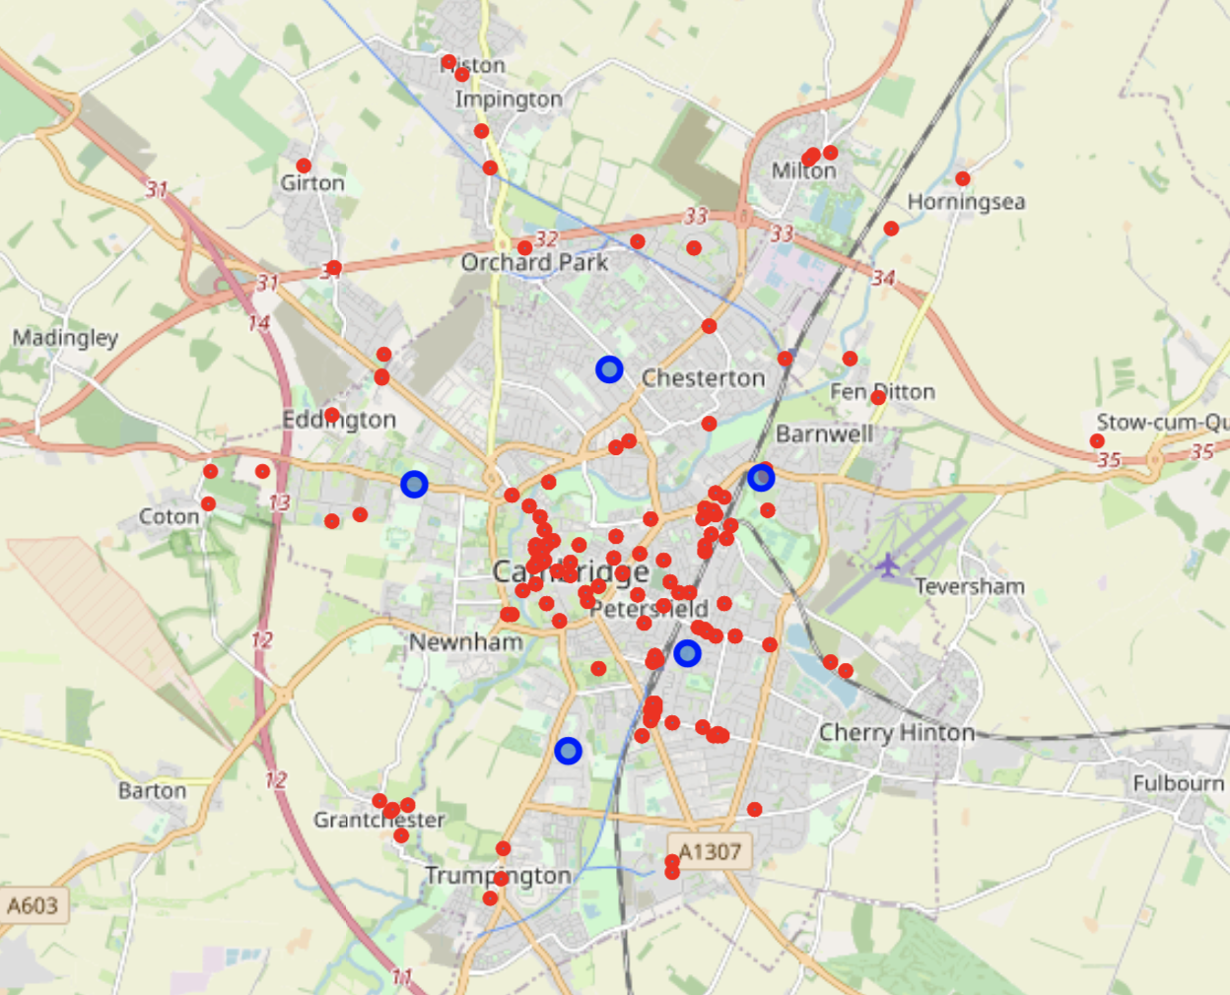
Local Venues
Foursquare API used to collect information
on all Venues within Cambridge.
Visualized on interactive map in relation to our
Candidate areas.

Slide 10
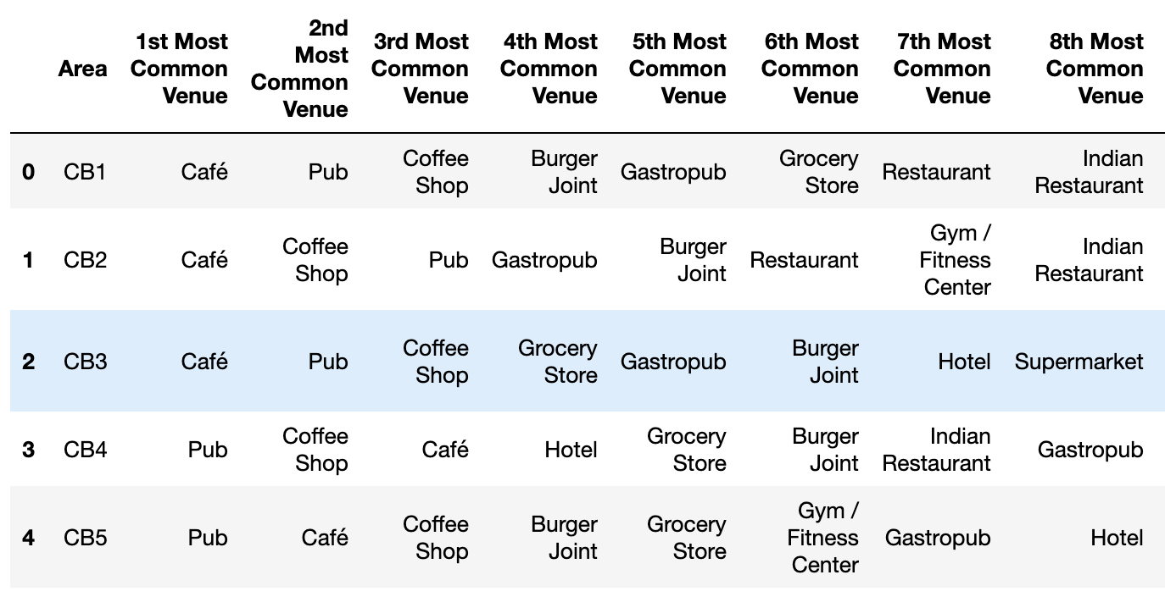
Closest Venues
Info on most common venues within each area allow us to select locations that will best suit the chosen demongraphic – young professional may want more Bars/Pubs and Coffee shops/Cafes

Slide 11
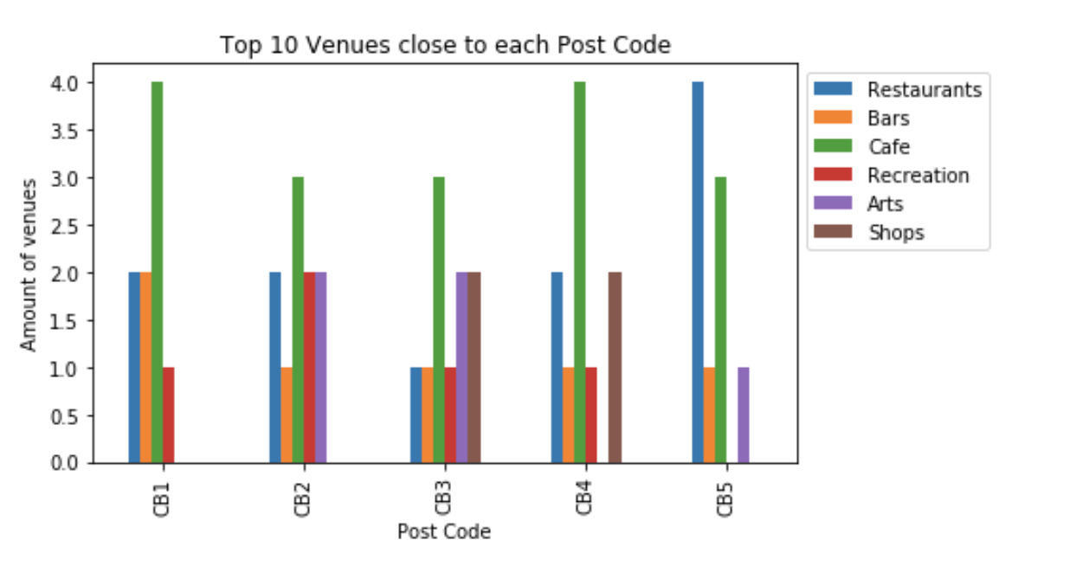
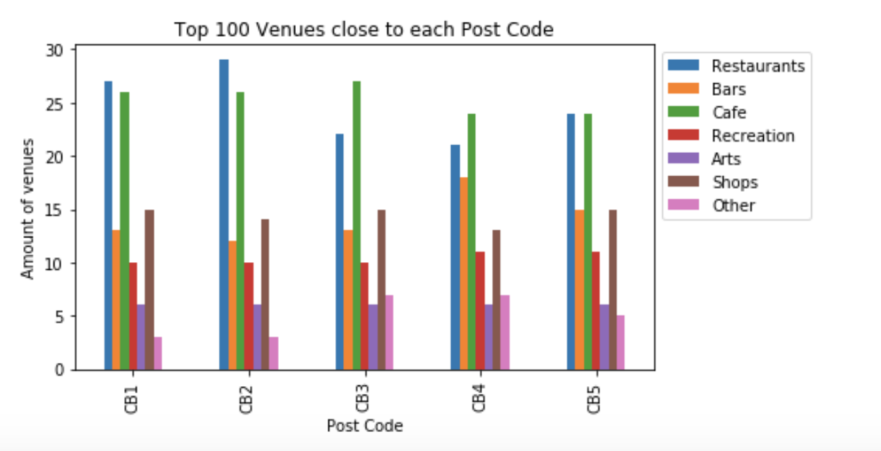
Top Venues – Clustered into Subgroups
Analyzing closet 10 and 100 venues subcategorized provides info on the distribution of Venue types in the Areas

Slide 12
Conclusions
Our Suggestion to the developers would be to invest within the CB2 Area.
Its close proximity to the central station makes it ideal to commuters
It displays lower levels of reported crimes that the other areas
Its close to the most restaurants and many cafes and bars
Its 10 closest venues are a spread of many venues types making it ideal to all potential clients requirements

Slide 13
Future Suggestions
Break down crime data into subgroups and analyze
Search for information on Housing prices within City and cluster to our Areas to provide information on Area housing prices
Search for information on other transport links such as Bus stops and airports distance to provide further information on local transportation and commuter options.
Look at surrounding Towns and villages to determine their crime rates, local venues, housing prices and commuter links to the city to determine the chosen demographic would be willing to live further from the city center if it were to cost less.

